Slide 1

Containers in the Cloud: Navigating Azure’s Ecosystem
Choosing the Right Compute Service for Your Container-Based Projects

Slide 2
What we will cover today:
Why containers to host your compute service
Azure services that support containers
Choosing the right service
Cross-cloud comparisons

Slide 3
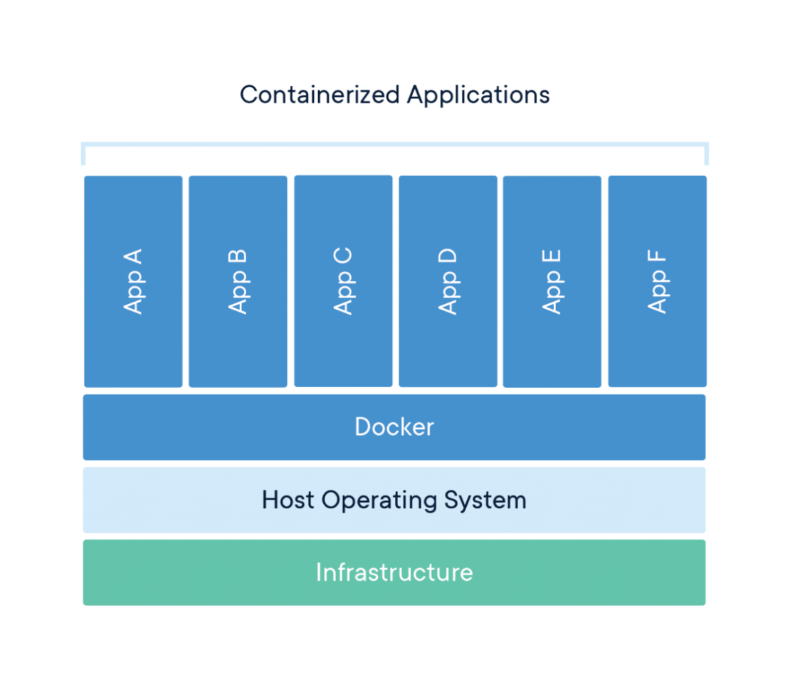
Docker

Slide 4
Why containers to host your compute service
Portability across environments
Faster deployment and scaling
Consistency
Microservices and cloud-native applications

Slide 5
Services that support container hosting
Azure Kubernetes Service (AKS)
Azure Container Apps
Azure Container Instances (ACI)
App Services with Containers
Azure Batch with Containers

Slide 6

Azure Kubernetes Service (AKS)
Ideal for complex orchestration
Full Kubernetes control
Cluster autoscaling, ingress controllers
Kubernetes knowledge required
Use cases:
Multi-service applications with custom networking
Deploying existing Kubernetes solutions to Azure

Slide 7
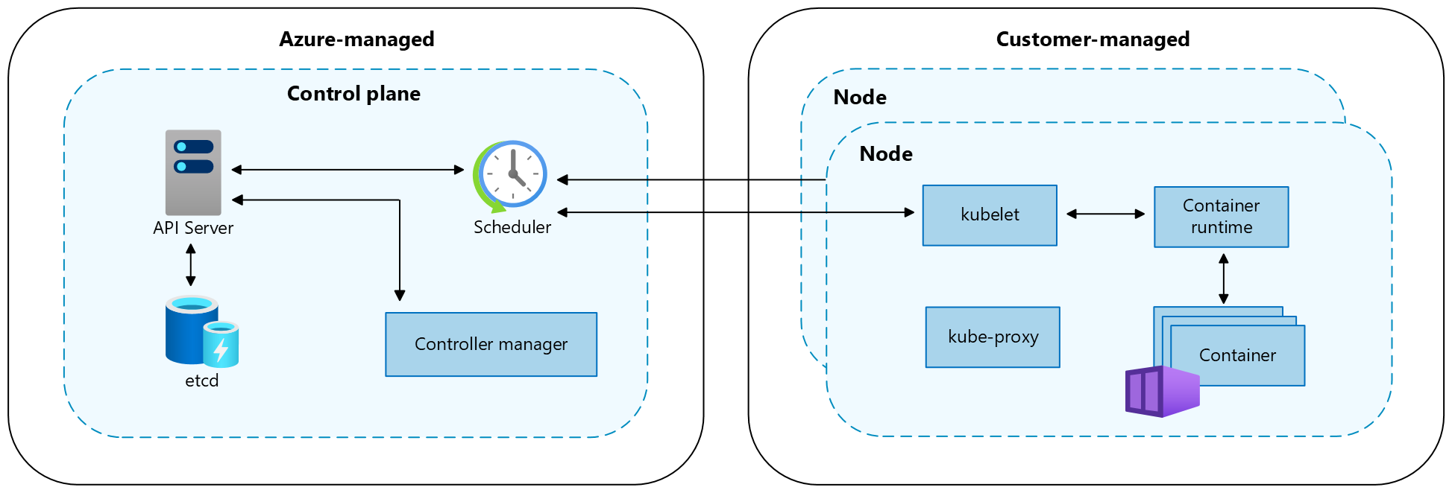
AKS Shared Management

Slide 8
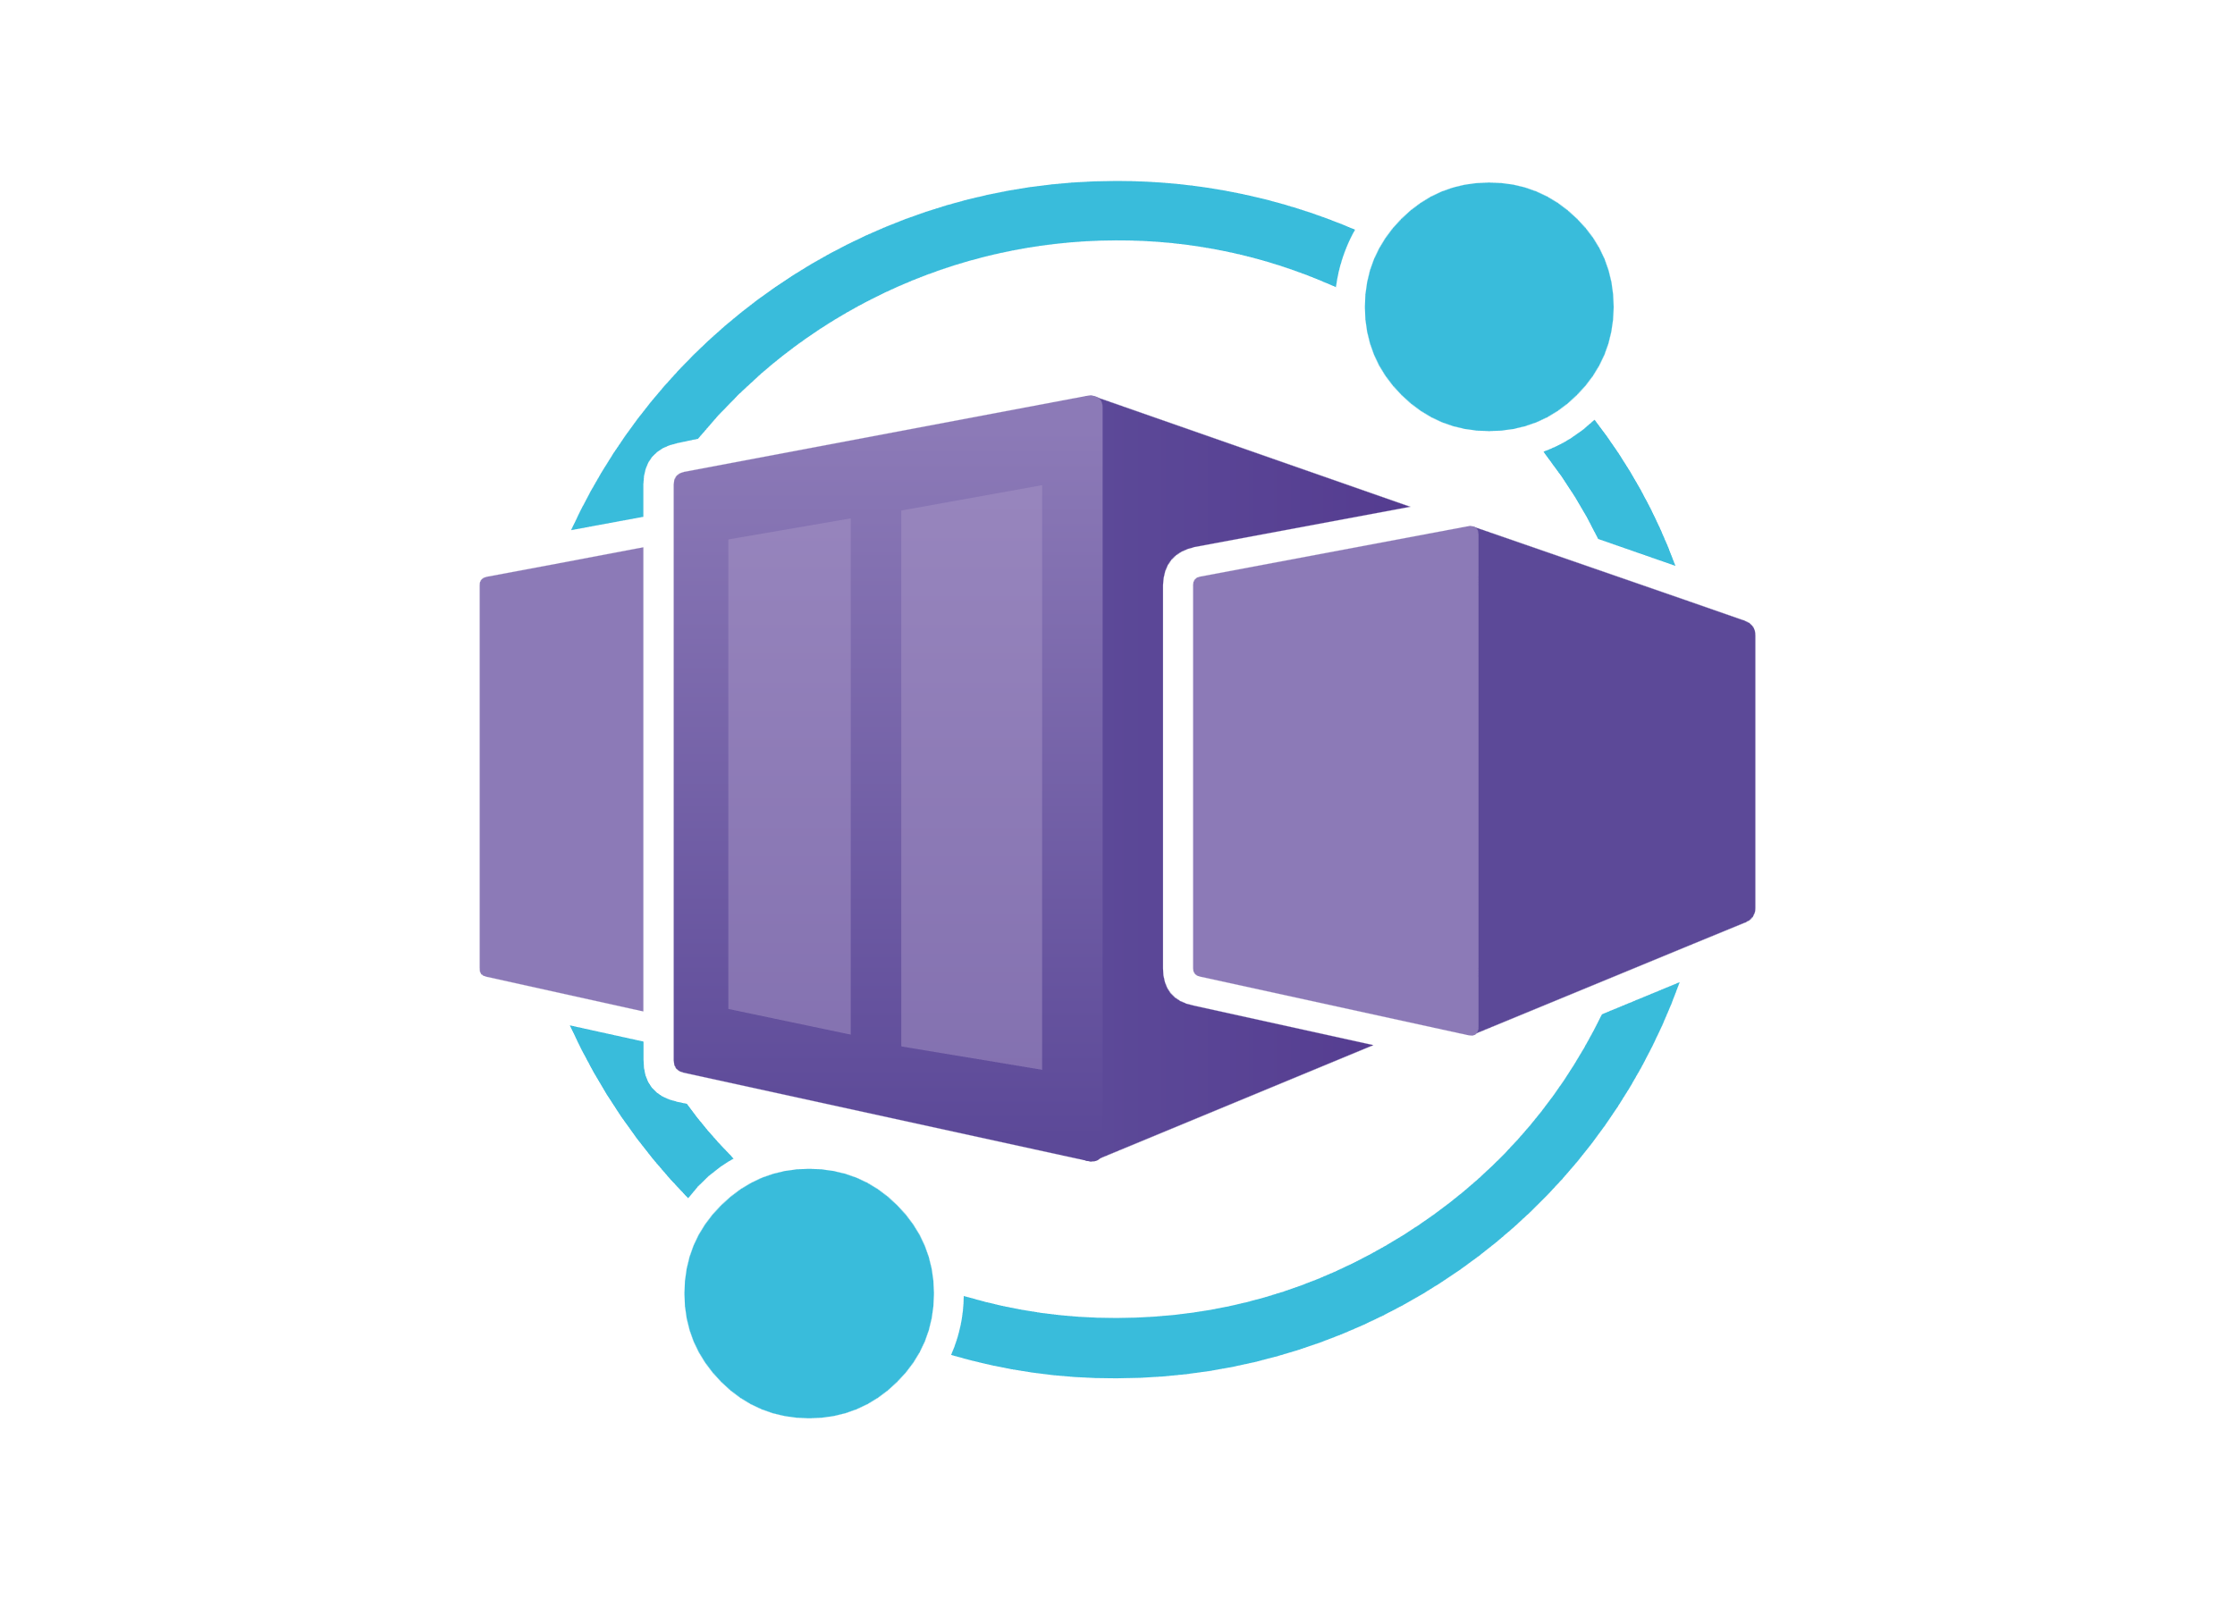
Azure Container Apps
Obfuscated, simplified Kubernetes
Serverless container platform
Consumption plans
Built on KEDA, Dapr, and Envy
Scale to zero, event driven
Use case: Custom built microservices with dynamic scaling

Slide 9
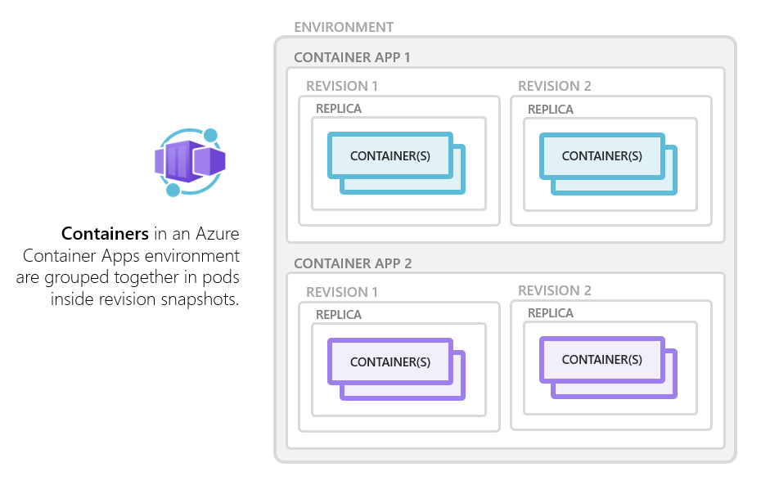

Slide 10

Azure Container Instances (ACI)
Fast, isolated container execution
No orchestrator overhead
Single pod or container group
Integrated with AKS through Virtual Nodes
Supports Windows containers
Use cases: One-off jobs, quick tasks, contained solutions

Slide 11
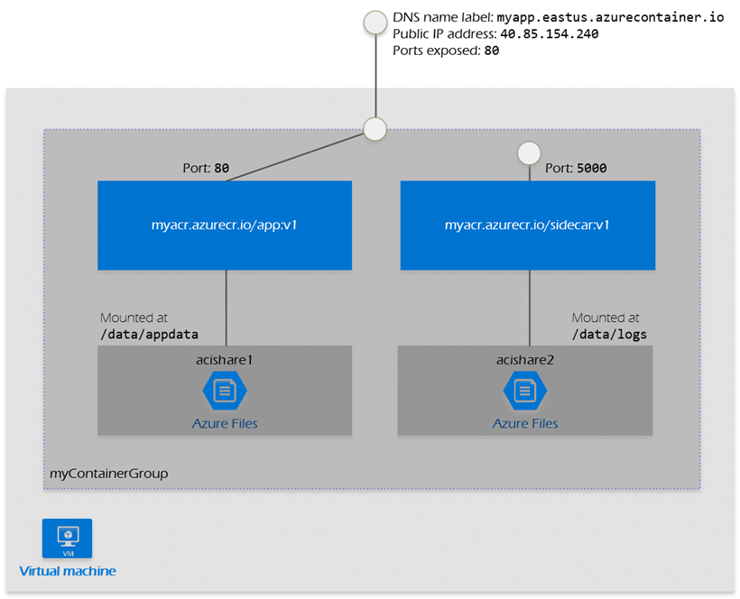
Container Groups

Slide 12
NGroups (Preview)
Container Groups
Single VM
NGroups
VM Scale-Set
Multiple Conatiners
Multiple Containers per VM

Slide 13

Containers in App Services
Use containers to deploy solutions onto Azure App Services
Supports Linux and Windows
Github: Azure-App-Service/dotnetcore
Create custom containers and sidecars
Deploy Azure Functions using containers
Use case: Web apps with complex configuration

Slide 14
Azure Functions with containers
Language specific base images
Not supported in consumption plans
Deploy to either App Services or Container Apps
Use KEDA to trigger Functions on AKS (Kubernetes)

Slide 15

Azure Batch Using Containers
Consistency
Parallel processing at scale
More complex
Build a VM Image with Docker enabled
Docker-enabled processes with other batch-based processes
Use case: Data processing, simulations, GPU processing

Slide 16
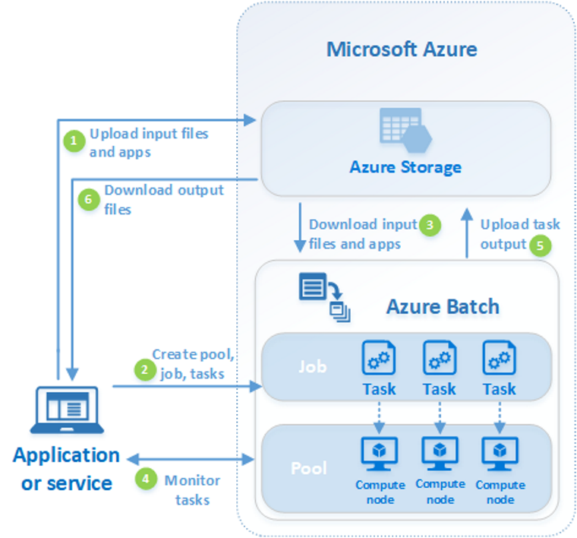

Slide 17
Choosing the Right Service
Complexity
Scaling Needs
DevOps Maturity
Cost

Slide 18
Examples
Microservices with custom ingress → Azure Kubernetes Services
Dapr Microservices → Container Apps
Windows IIS Application → App Service
Quarterly backend batch job using legacy script or executable → Azure Batch

Slide 19
Cross-Cloud Comparison
Feature | Azure | AWS | GCP
Orchestration Platform | AKS | EKS | GKE
Serverless Containers | Container Apps | Fargate | Cloud Run
Registry | ACR | ECR | Artifact Registry
Quick Containers | ACI | Lambda Containers | Cloud Functions

Slide 20
Demo: Deploy to Azure Container Apps

Slide 21
Resources
What is a Container? | Docker
Comparing Container Apps with other Azure container options | Microsoft Learn
Quickstart: Run a custom container on App Service - Azure App Service | Microsoft Learn
Github: Azure-App-Service/dotnetcore
Work with Azure Functions in Containers | Microsoft Learn
Cloud Run | Google Cloud
Amazon Fargate for Amazon ECS - Amazon Elastic Container Service

Slide 22
Thank you
Please complete your surveys!

